Slide 1

DBMS Project
Team Name:- Technophiles

Slide 2

Team Members
Ashis J Kalathil (20bcs022)
Chaitanya Giri (20bcs034)
Dipesh Mishra (20bcs043)
Harshal Dube (20bcs052)
Hemang Ranga (20bcs057)
Michael Roy (20bcs010)
Prathamesh Pai (20bcs103)
Sunil Patidar (20bcs131)
Gitesh Ambre (20bcs009)

Slide 3






Tech Stack

Slide 4
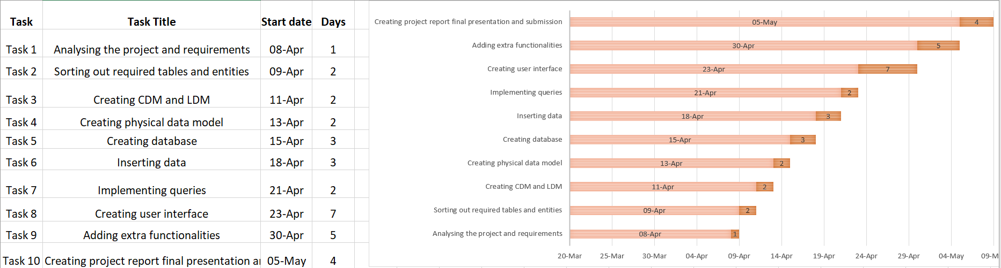
Timeline

Slide 5
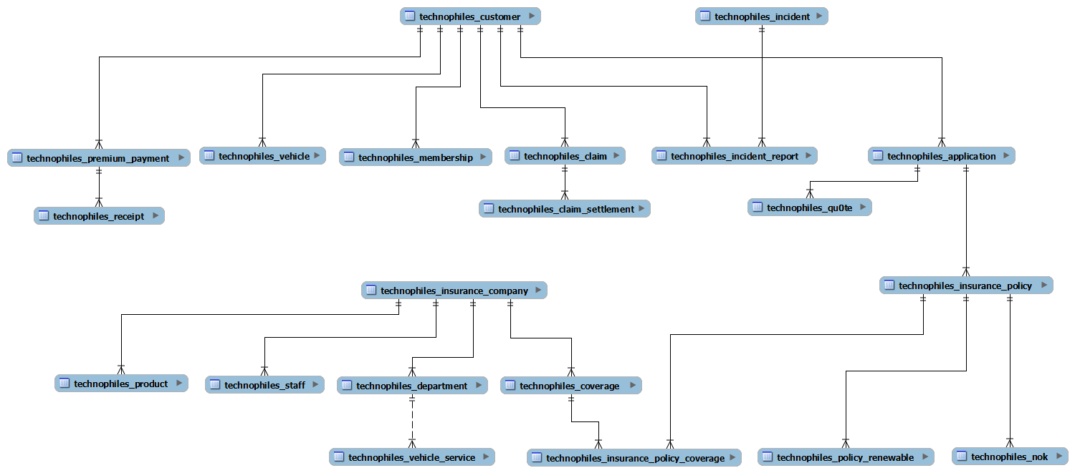
Conceptual Data Model

Slide 6
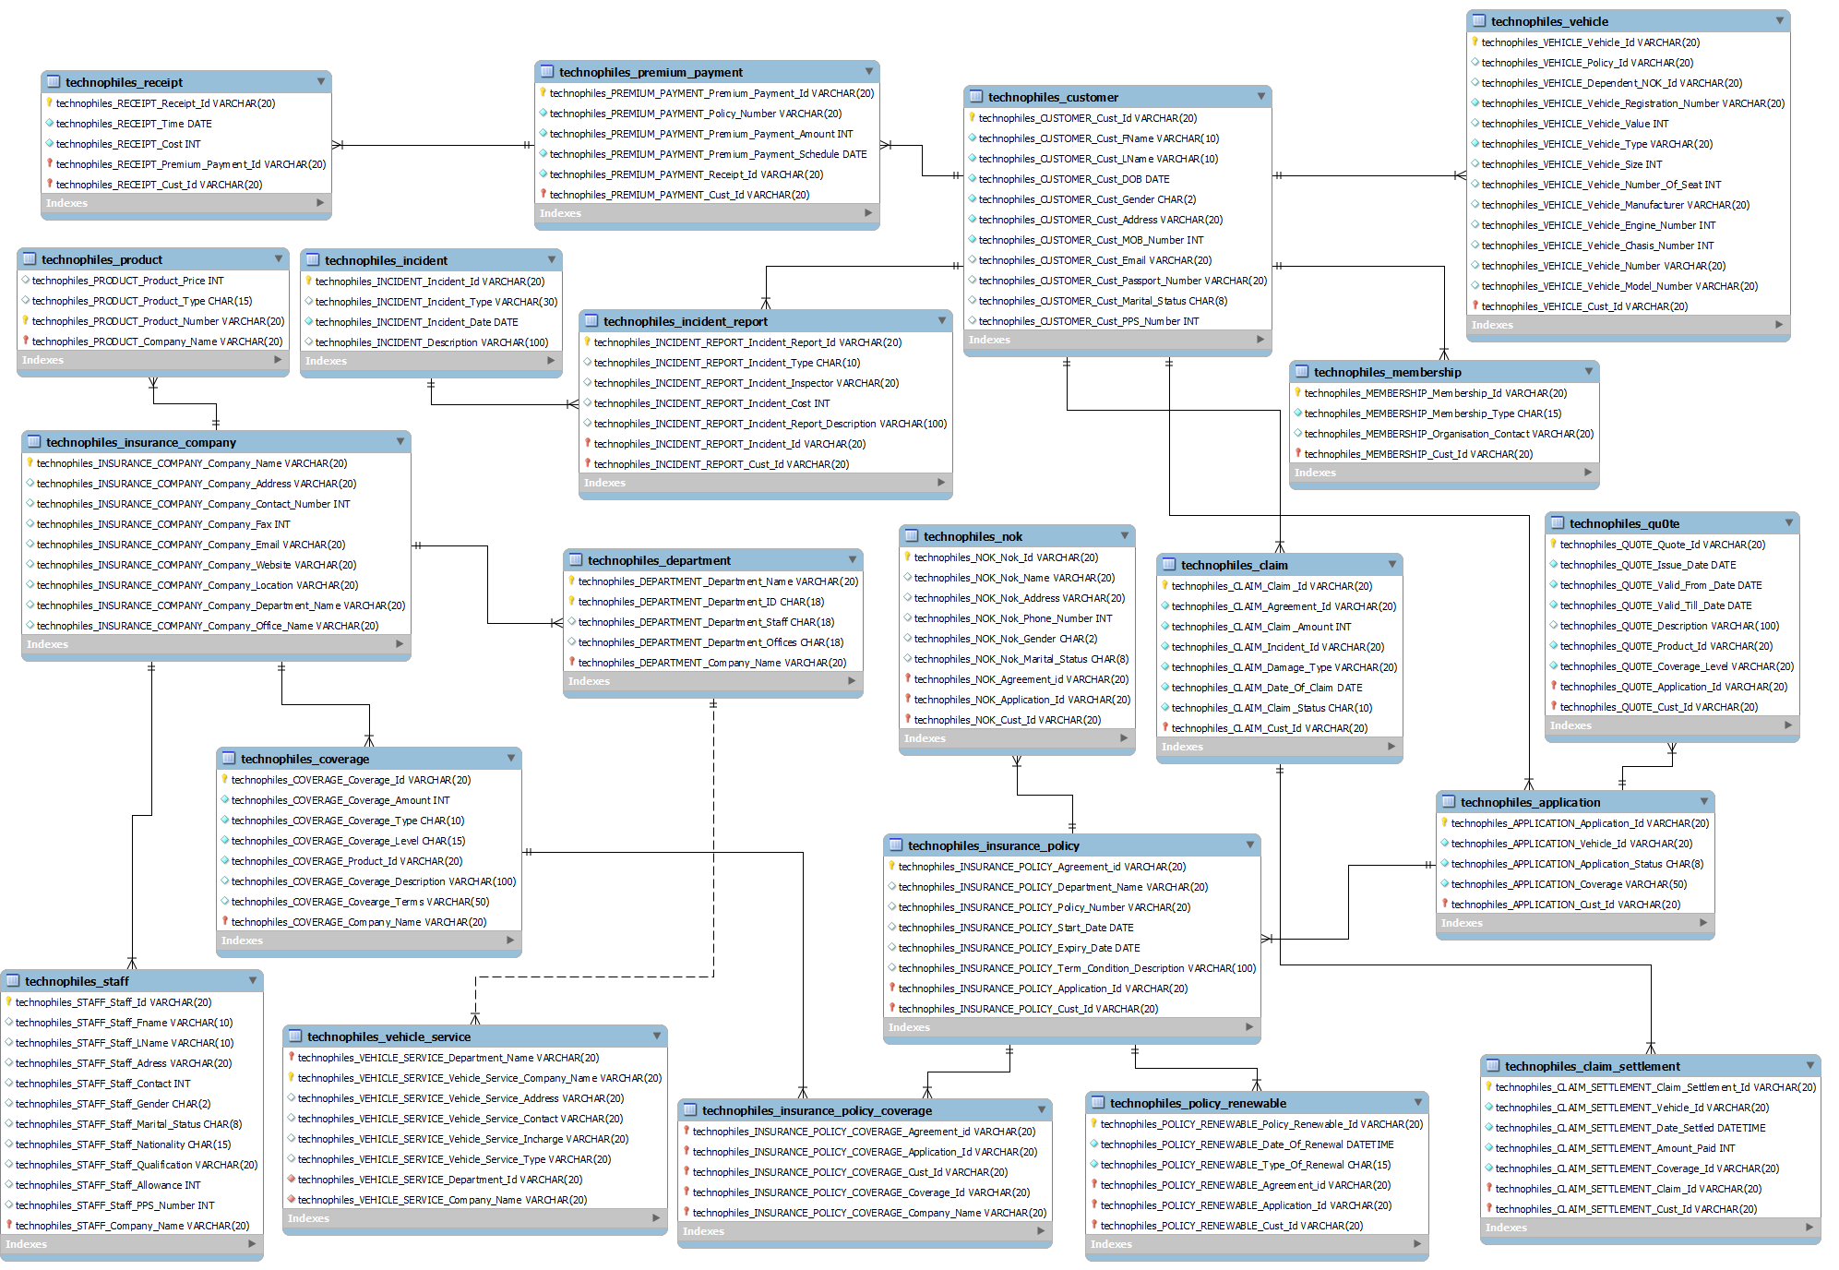
Physical Data Model

Slide 7

Queries

Slide 8
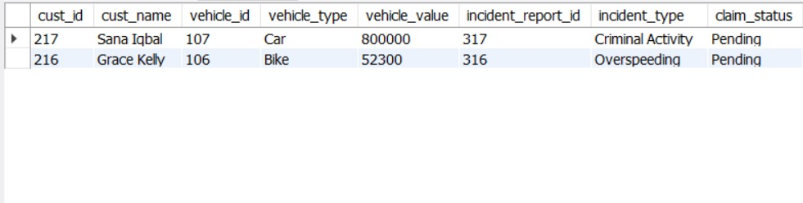
Query 1
Retrieve Customer and Vehicle details who has been involved in an incident and claim status is pending

Slide 9
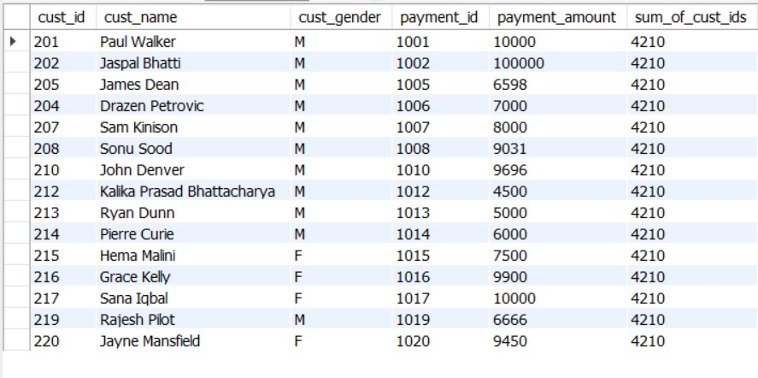
Query 2
Retrieve customer details who has premium payment amount greater than the sum of all the customer Ids in the database

Slide 10
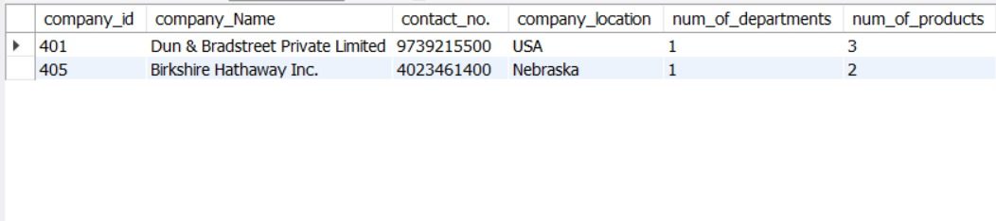
Query 3
Retrieve Company details whose number of products is greater than departments, where the departments are located in more than one location

Slide 11
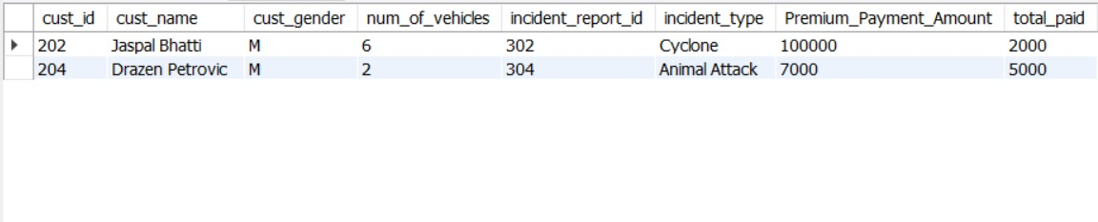
Query 4
Select Customers who have more than one Vehicle, where the premium for one of the Vehicles is not paid and it is involved in accident

Slide 12
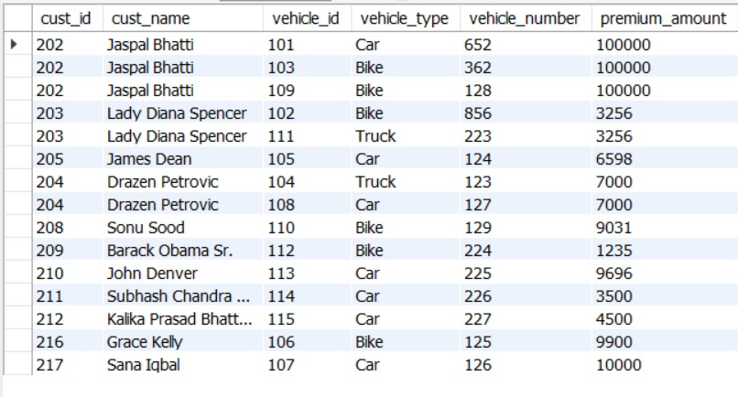
Query 5
Select all vehicles which have premium more than its vehicle number.

Slide 13
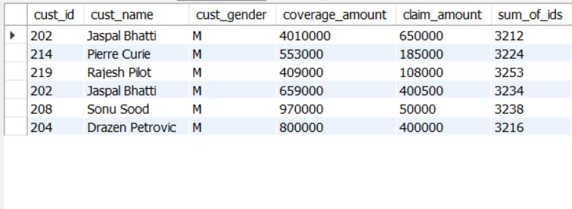
Query 6
Retrieve Customer details whose Claim Amount is less than Coverage Amount and Claim Amount is greater than Sum of (CLAIM_SETTLEMENT_ID, VEHICLE_ID, CLAIM_ID, CUST_ID)

Slide 14

Thank You

